Slide 1
VANKADARA MOHANA PRIYA
-FINAL PROJECT

Slide 2

KEY LOGGER AND SECURITY
Understanding Methods and Mitigation

Slide 3


AGENDA
PROBLEM STATEMENT
PROJECT OVERVIEW
WHO ARE THE END USERS?
YOUR SOLUTION AND ITS VALUE PROPOSITION
THE WOW IN YOUR SOLUTION
MODELLING
RESULTS
CONCLUSION
PROJECT LINK
3/21/2024 Annual Review

Slide 4

PROBLEM STATEMENT
DEVELOP A SECURE AND USER-FRIENDLY KEYLOGGER APPLICATION THAT CAN MONITOR AND RECORD KEYBOARD INPUT AND
ENHANCE THE EXISTING KEYLOGGER APPLICATION TO INCLUDE ADVANCED FEATURES THAT DETECT AND PREVENT POTENTIAL SECURITY THREATS.

Slide 5

PROJECT OVERVIEW
This project is a comprehensive security solution that addresses various security threats and weaknesses in addition to monitoring and recording keyboard input in real-time.
Investigate key loggers, develop methods to identify and stop them, and ensure strong data security and privacy.
Python-based keylogger with GUI
Compatible with multiple operating systems and devices.
The significance of creating efficient solutions in the field of cybersecurity.

Slide 6


WHO ARE THE END USERS?
Businesses and Organizations: Large corporations and enterprises.
Law Enforcement and Forensic Investigators: Investigating cyber crimes and analyzing digital evidence.
Cybersecurity professionals: To monitor and detect potential security threats.
IT and Network Professionals: Network Administrators monitoring user activity on company devices

Slide 7

YOUR SOLUTION AND ITS VALUE PROPOSITION
Solution:
Key Logger Detector (KLD) - A comprehensive security tool that detects and prevents keylogger attacks in real-time, providing an additional layer of protection for sensitive data and systems. Key Logger Protector (KLP) - A user-friendly and secure keylogger application that records and saves keyboard input.
Value Proposition:
A simple and intuitive interface makes it easy to deploy and manage.
Helps organizations meet regulatory requirements and industry standards for security and privacy.
Detects and prevents keylogger attacks, reducing the risk of data breaches and cyber threats.
Records and saves all keyboard input, providing a complete record of user activity.

Slide 8

THE WOW IN YOUR SOLUTION
Innovative approach: The solution takes an innovative approach to addressing keylogger attacks, using real-time detection and prevention, and providing a secure keylogger application.
Real-time detection and prevention: KLD detects and prevents keylogger attacks in real time, ensuring that sensitive data and systems are protected from potential threats.
Dual-layer protection: The combination of KLD and KLP provides a dual-layer protection approach, ensuring that users are protected from keylogger attacks and also have a secure way to record and save keyboard input.
8

Slide 9
MODELLING
Event Handling: Utilizes the functionality of pynput library to manage and record keystroke events. Listens for keyboard input and triggers functions to log data.
Data Logging: Implements functions to log captured data into text and JSON files. Logs data in real-time, allowing for immediate analysis.
Modular Design: The keylogger code is structured into modular functions, each with a specific purpose, making it easier to understand and maintain.
9

Slide 10
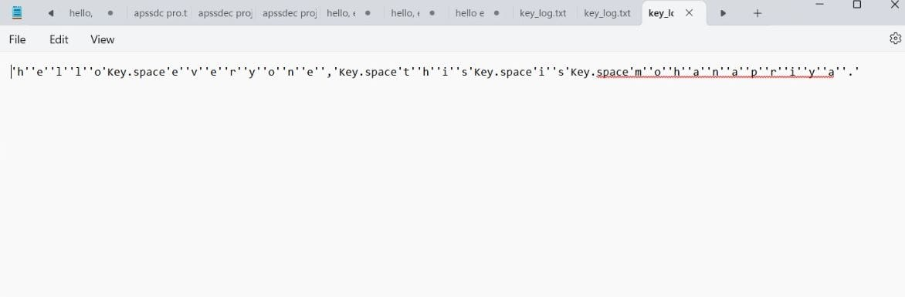
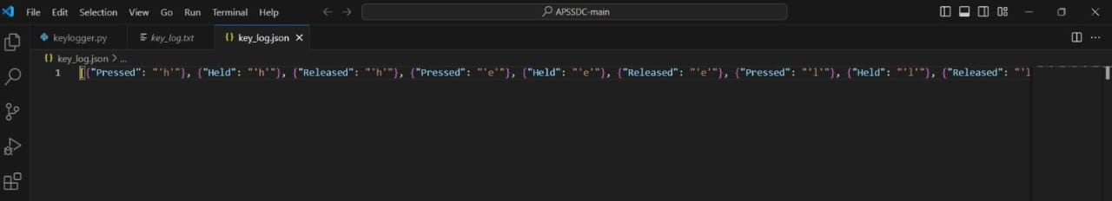
RESULTS
10

Slide 11
CONCLUSION
Successfully developed a key logger that can capture and record keyboard input in real-time
Implemented features to log data into text and JSON files
Implemented encryption for log data to protect against unauthorized access
Developed access control mechanisms to ensure only authorized users can view log data
Added functionality to encrypt log data for added security
Created a user-friendly interface for starting and stopping the key logger
Added authentication protocols for administrators to configure security settings
Conducted thorough testing to ensure the security of the system

Slide 12

PROJECT LINK

